Slide 1
Capstone Project: Entertainment Facility Recommendations in London Remon Do

Slide 2
Introduction
Description of the problem
Entertainment place recommendation is a challenging task
The preference of entertainment varies in different time intervals or period
Entertainment preference also varies from culture to culture

Slide 3
Introduction
Background
London is one of the most attractive locations in the world
London is one of the most diverse cities in the world
Places that are convenient, high-rated, and affordable should be given priority
An efficient recommendation system should be considered
This can give reasonable suggestions for people to find the right place

Slide 4
2. Methodology
Data
https://en.wikipedia.org/wiki/ListofareasofLondon
Many of the world’s largest tech companies rely on Foursquare data to add location intotheir apps and services
This project will take benefits from the FoursquareAPI application to access available data for the investigation.

Slide 5
2. Methodology
Data Handling
BeautifulSoup library in Python is usedto read the HTML content of data
obtained data will be fed into dataframe to extractthe most informative attributes
A map of theselocations should be displayed to facilitate the visualization for custumers

Slide 6
3. Data Acquisition and Processing
Data Acquisition
Data collected from London postal district database includes several important attribute:
Location
Borough
Post town
Postal code
Dial code
OS grid ref

Slide 7
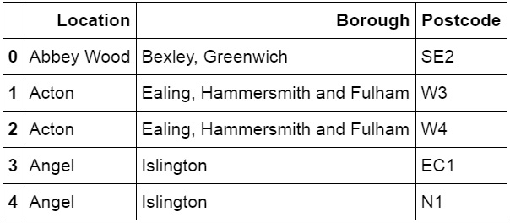
3. Data Acquisition and Processing
Feature Extraction

Slide 8
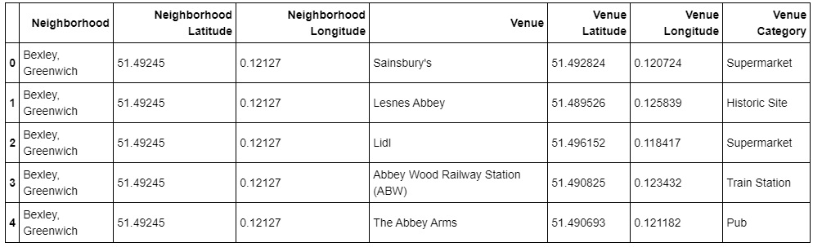
3. Data Acquisition and Processing
Geographical Location Mapping

Slide 9
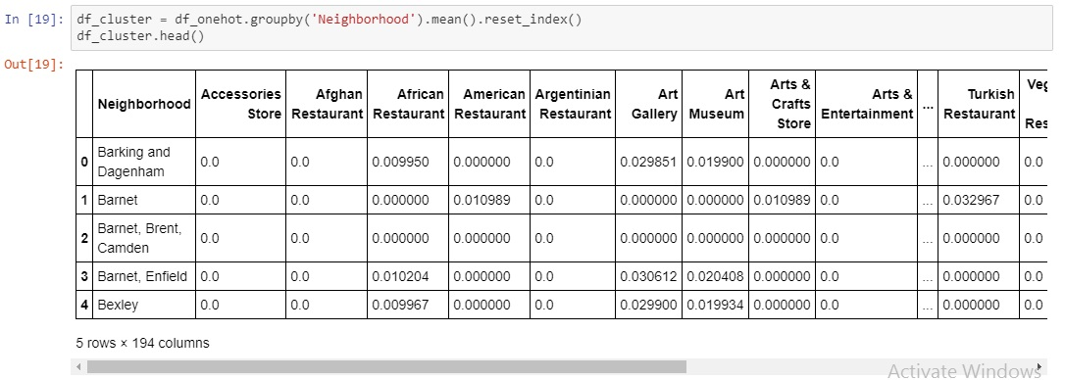
3. Data Acquisition and Processing
Feature Representation

Slide 10
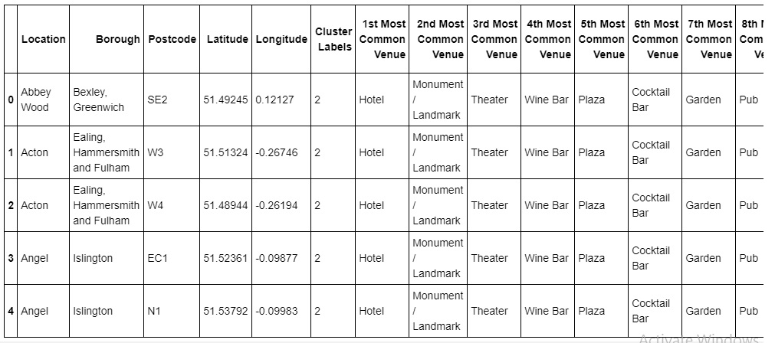
4. Results
Common venues by cluster labels

Slide 11
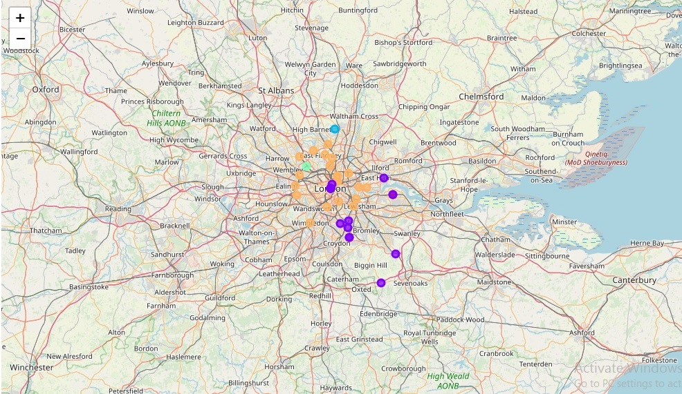
4. Results
Folium map of common venues in London

Slide 12
5. Discussion
Through results and analysis in the previous section, it can be seen that London offers one of the planet’s greatest concentrations of cultural attractions. From accommodation palaces such as Hotel to the people’s entertainment needs, from Theater and Plaza to Monument/Landmark for breathtaking views. Moreover, tourists could spend endless days exploring London’s night life facilities like Wine/Cocktail Bar or Art without ever running out of unique things to see and do.

Slide 13
5. Conclusion
The key idea was to use user data from Foursquare and recommend individuals to venues. The primary conclusion I reached to after trying several recommendation models was: The concept of geographic distance is as important as the user’s taste in all venue categories. In simpler terms, this means that the likelihood of a person visiting a restaurant depends a lot on the geographic location of the restaurant and not just the users taste alone! So how could this conclusion help a data engineer come up with an answer to the venue commendation problem? This project will help users to use data and data models to come up with an answer for queries like: Given a venue (e.g. an Indian Restaurant), select individuals who are likely to visit it. These kinds of queries come under the broad purview of “venue recommendation”.

Slide 14
Thank you!

